Slide 1

retail Store management system
This Photo by Unknown Author is licensed under CC BY-NC

Slide 2
CONSULTANT Md. Moshaidul Islam wdpf.idb-bisew it scholarship Email: moshaidul@gmail.com
Instructor
FARHANA AKTER LUCKY
wdpf.idb-bisew it scholarship

Slide 3
Md. Moshaidul Islam
Consultant
WDPF-IDB-BISEW
IDB Bhaban
Sher-e-Bangla Nagar, Dhaka
Subject: Management Web Application Project Proposal
Dear Sir
Thank you for offering me a great opportunity to make a real life project based on our core course that
is Web Development with PHP and Framework (WDPF). In this respect, I would like to inform you that I
have decided to make a project on Education Management System, which is most importance for every
business communities. I have studied about the various aspects of this system and make a proposal
accordingly which is enclosed herewith for your kind perusal. So, I think you will finally Approved the
project and help to utilize my creativity.
Sincerely
Rainbow-Group
ID:1272591

Slide 4
List of Details
Add/Delete/Update the customer details.
Add/Delete/Update the available product details.
Add/Delete/Update the description of new products.
Add/Delete/Update the employee details.
Add/Delete/Update the product categories.
All type of reports to the owner daily/weekly/monthly/yearly.
All the billing details.

Slide 5
Project Overview
Administration and management of a departmental store is an essential part of the overall working and function of a departmental store. Particularly in the case of bigger stores, there will be several products and number of sections. So good and effective use of resources and effective management is necessary to the success and smooth working.
Problem Definition
In the existing Store Management System departmental store management system, most of the work is completed manually by using paper records. It is a place where we get all our daily use basic requirement products. This is one of the difficult job to administrate. Most of these jobs are done manually. This includes many drawbacks,
Increases the paper work
Time consuming
Loss of information
Security issues
Lack of integrated resources
Data duplication

Slide 6
Module 1:
Customer/User Module
Data entry operator of the store will enter all the required details in the application. Details include,
Customer details.
Available product details.
Description of new products.
The product categories.
Unit Price for the products.
Billing details.
Module 2: Server
All the entered details and updated details will be stored in the server. The server details will be have backup facility everyday.

Slide 7
Module 3:
Data Analysis
All the details entered in the database will be analysed using statistics, business intelligence and data mining. This will provide better understanding of the business.
Some of the business questions/statistics,
How many number of items sold today?
What is the total sales today?
How week day sales differ from weekend sales?
What is the category wise sales today?
What is the weekly sales?
What are items frequently purchased together?
What is the monthly sales?
What items can be best to provide offers?
What is the yearly sales?
Is attendance statistics of working employees good?
Module 4: Reporting & Visualization
After the data analysis, the analyzed results need to be visualized. Tableau can be used for this purpose. Bar charts, Line charts and Pie charts are generated along with the table format.

Slide 8
Store Management System Benefits
User friendly
Easy to modify the details
Less paper work
Human and manual work reduced
Automated reporting
Software Requirements
PHP
MySQL
Hardware Requirements
Hard Disk – 500 GB or Above
RAM – 8 GB or Above
Processor – Core i3 or Above

Slide 9
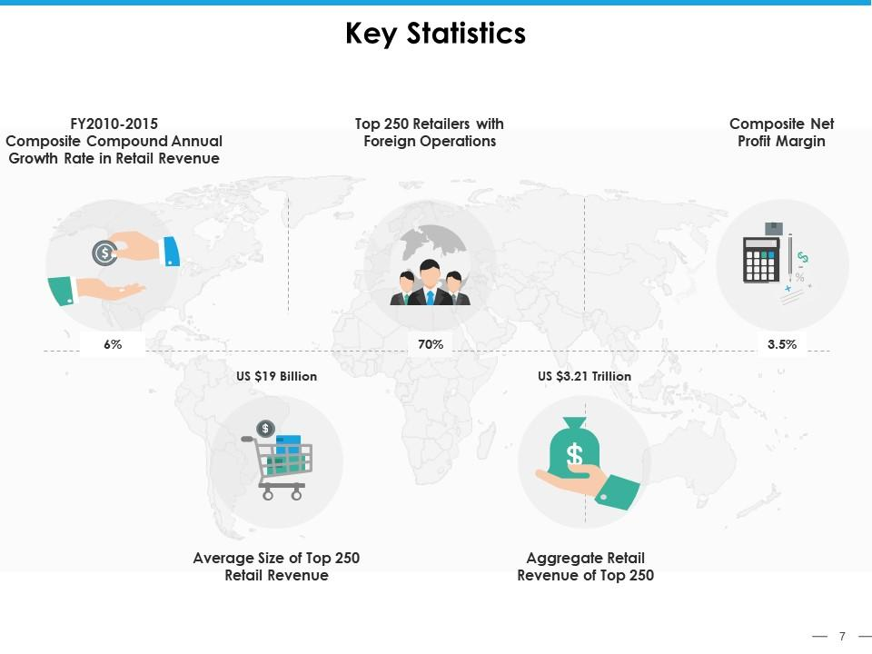

Slide 10
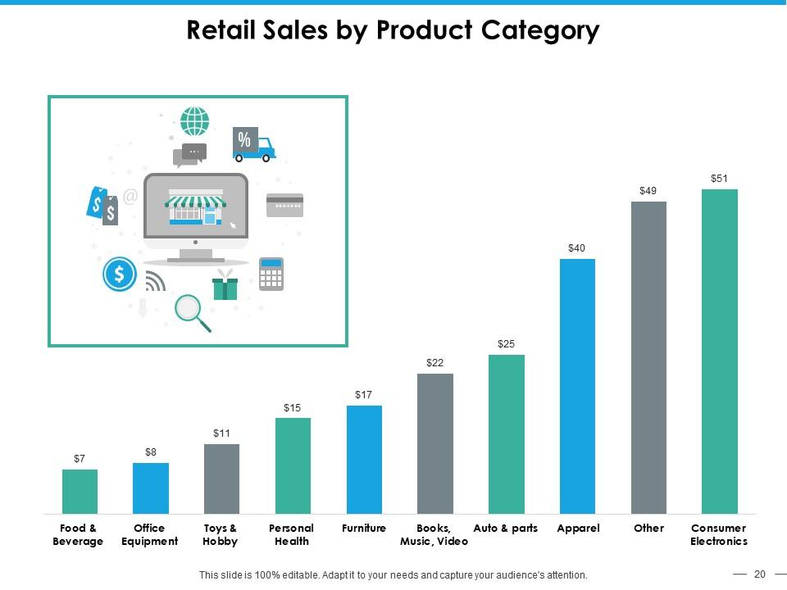
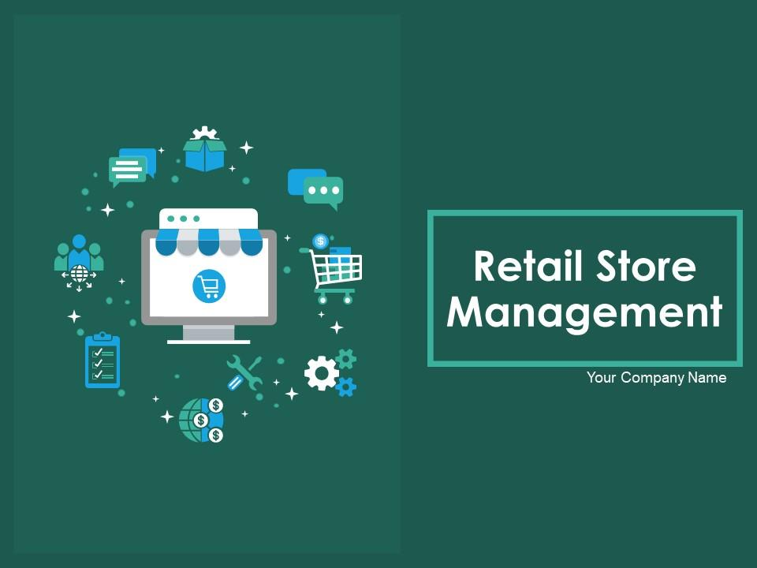
Our team members
Shariar shakil
somting
mamun
Rafia khan tuly
Fima apa

Slide 11
Thank you
Brita Tamm
502-555-0152
brita@firstupconsultants.com
www.firstupconsultants.com

